Slide 1


Electronics and Robotics
2nd Semester

Slide 2

What is a CTE class?
A program that helps you develop the skills and knowledge you need to succeed in high-wage, in-demand careers
A program of study is a series of courses that get progressively more in depth and ends with a recognized credential or degree.
Nyssa High School offers:
Agribusiness Systems - FFA
Construction Trades
Business
Health Sciences
Welding
Building:
Computer Science
Culinary Arts

Slide 3
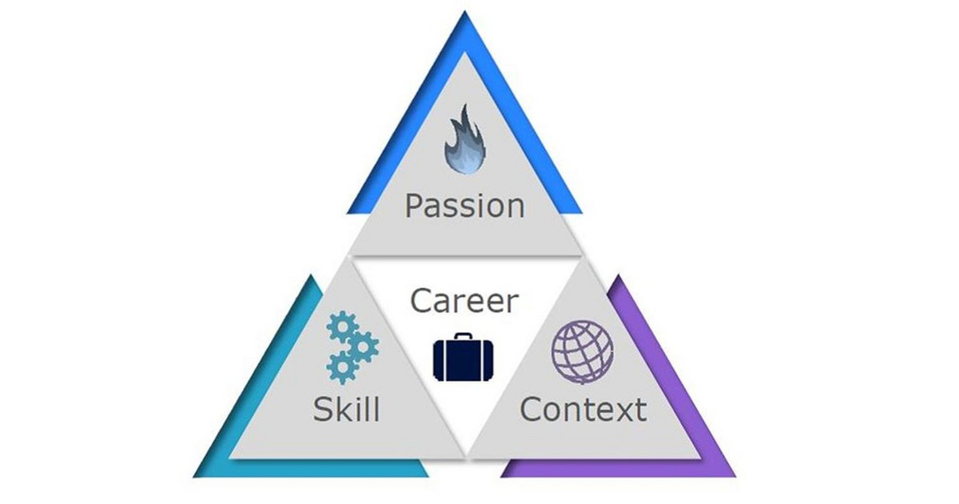
Career Connection
Skill - Passion - Context
What are you naturally good at?
What type of work do you enjoy?
Do you like to solve technical problems?
Do you enjoy working with a computer?
Are you good at handling frustration when things are complicated?
What does the world need?

Slide 4
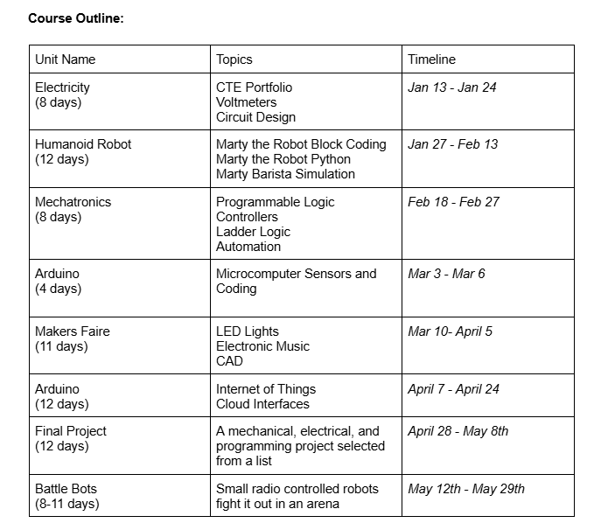
Spring Semester
Electronics & Robotics

Slide 5
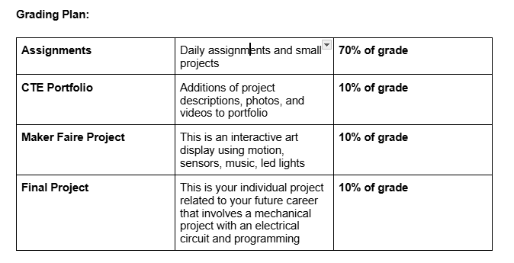
Syllabus Review

Slide 6
CTE Portfolios
Above and beyond a resume - A collection of work and documentation that showcases your skills, achievements, and progress for a specific CTE experience.
We will use Canva to create these portfolios and work on adding information on a weekly basis.
This is being done in other CTE programs as well, so you might have a shared portfolio between programs.

Slide 7
YouScience
We will focus on career connected opportunities and use your YouScience data to help direct your project choices.
For example if you are interested in athletic training, your robotics projects can be around solving an athletic training problem.

Slide 8
Classroom Expectations
Bell Schedule
2 minutes flex
Restroom Use
Water/Drinks/Snacks
Computer Use
Laptop Charging
Laptop Mice
2nd Screens
Headphones
Advisory / OTI

